Slide 1

ISYS90118: Research Methodologies
Shanton Chang

Slide 2

Skills for IS Research and Development: Today’s Lecture
Qualitative Methods
What are Qualitative Methods?
What are qualitative methods used for?
Quantitative Methods
What are Quantitative Methods?
What are quantitative methods used for?
Mixed Methods
What about Mixed Methods?
What are mixed methods used for?
What are the types of questions of interest to qualitative IS researchers?
Let’s have a look at different qualitative methods
What are the types of questions of interest to quantitative IS researchers?
Let’s have a look at different quantitative methods
What are the types of questions of interest to mixed researchers?
Let’s have a look at different approaches to mixed methods

Slide 3

Let’s Start Here:
Some Important Distinctions about Types of Research
Sample/Respondents vs Population
Propositions/Open Questions vs Hypotheses
Exploratory vs Confirmatory
Interpretivist vs Positivist
Inductive vs Deductive
Subjective vs Objective

Slide 4

What is Qualitative Research?
Action Research (What is the experience of the researcher in the context / phenomenon?)
Case Study (What are the different perspectives within a case?)
Ethnographic (How do people of a particular group behave, or react or make decisions?)
Historical (What was the experience of the people and groups or organisation and the context in hindsight?)
Phenomenological (How do people make sense of their experience, and their perspective of their context?)
Is your RQ here?

Slide 5
What are characteristics of Qualitative Methods?
Key Words: Exploratory, Inductive, Interpretivist, Subjective
Purpose: To understand the phenomenon and richness of experiences within the context
Principle: Story Telling and Rich Data are important to explore the range of experiences rather than a summative approach to understanding a phenomenon or research question.
Analysis can be subjective but that’s ok – because you are not trying to explain in a generalisable or universal manner.
Why is the qualitative approach still relevant?

Slide 6
Different Qualitative Methods
Open Interviews, Semi-structured Interviews, Structured Interviews (with Individuals)
Focus Groups – group interviews with groups of participants / respondents
Delphi Techniques – where individuals are asked to answer some questions individually – their responses are collected and summarised, and then checked in the group for further responses
Observations – where the researcher observes what is going on and notes them down

Slide 7
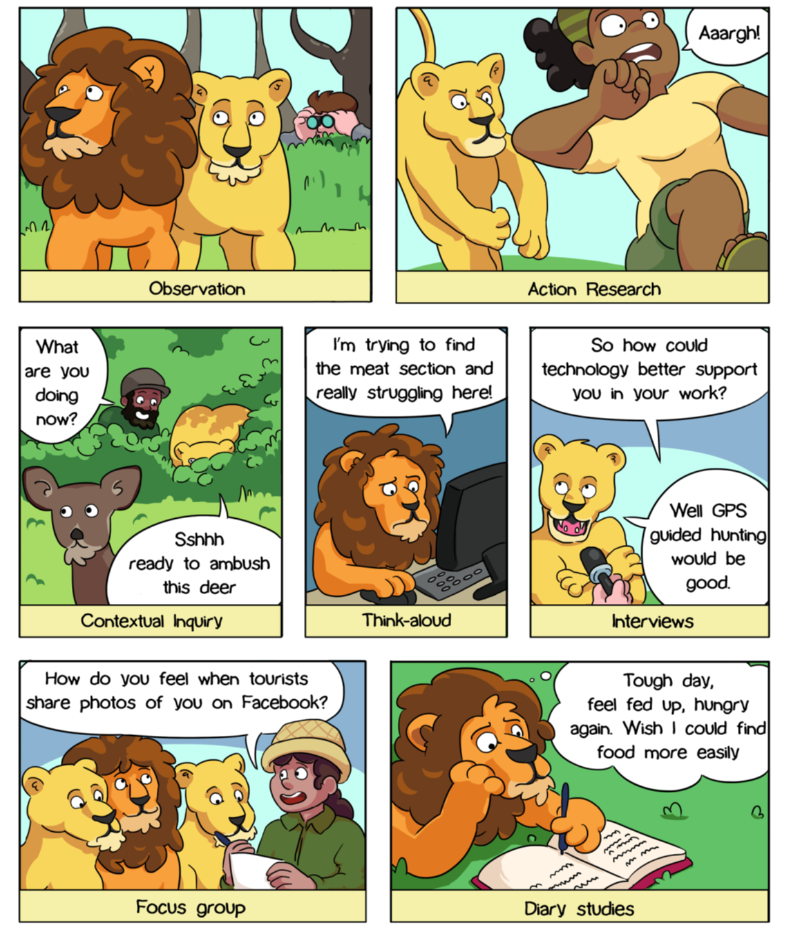
Qualitative Methods
From: Blandford, A., Furniss, D., & Makri, S. (2016). Qualitative HCI research: Going behind the scenes. Synthesis Lectures on Human-Centered Informatics, 9(1), 1-115.

Slide 8
Analysis in Qualitative Methods
Content Analysis
Grounded Theory
Story Telling
Conceptualisations

Slide 9

What is Quantitative Research?
Descriptive (What are the variables and the factors in the phenomenon?)
Correlational (Are variables related to each other in some way(s)?)
Causal or Comparative (What factors caused something to happen? Are there differences in different contexts (control groups)?)
Experimental (What if we did something different? What if we intervened or introduce an intervention?)
Is your RQ here?

Slide 10
What are characteristics of Quantitative Research?
Key Words: Statistical, Confirmatory, Deductive?, Positivist, Objective?
Purpose: To understand the phenomenon through objective measures that try to be generalisable
Principle:
Analysis is claimed to be more objective and therefore, reliability, validity and generalisability are important
Why is the quantitative approach still relevant?

Slide 11
Different Quantitative Methods
Experiments and Quasi-experiments (where an experiment is conducted and quantitative data is collected)
Surveys (online vs offline, longitudinal vs cross-section, different types of sampling)
Closed Ended Interviews (interviews where questions are close ended – meaning there are selections of options for answers rather than open ended answers)
Document Coding (Reviews of existing documentation and applying a pre-determined code to analysis)
Social Media Analyics (Based on quantifiable data and metrics)

Slide 12
Analysis in Quantitative Methods
Statistics
Factor Analyses
Multiple Regressions
Comparative Stats

Slide 13


What are Mixed Methods?
Mixed Methods are a combination of quantitative and qualitative methodologies – which means there may be phases/stages to the study. These tend to answer questions from different perspectives. Here are some examples of sequential research;
  Quantitative Qualitative: (What followed by Why?)
  Qualitative Quantitative: (Context followed by generalisability?)

Slide 14
What are the challenges of Mixed-Methods
Resourcing
Approaches are not always complementary
Potential lack of focus

Slide 15
Some Key Important Considerations
Validity (Construct, Criterion, Content, Face) vs Appropriateness
Reliability (aka Repeatability, Inter-rater, Intra-rater) vs Consistency
Generalisability (across other contexts)

Slide 16
Research Proposal
Literature review
Writing your proposal
Research question
GenAI literature review

Slide 17
Research Proposal Appendix
RIOT Certificate
LLM-generated literature review + reflection
  Complete training
  Must show name
  Convert certificate into an image and add to your appendix
  Can use ChatGPT, Claude, Gemini, Mistral, etc.
  Prompt using your own research question, asking it to generate a literature review
  Provide 100-word reflection on the difference between your literature review and ChatGPT results
  Include prompt in appendix
  Include generated output
    Screenshot preferred

Slide 18
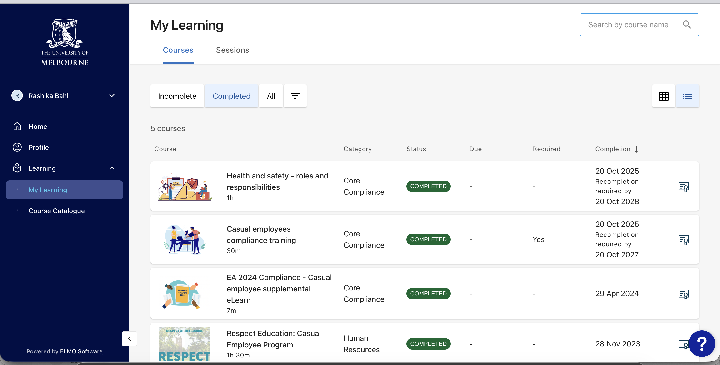

Slide 19
Using GenAI and Your Research Proposal
Dos
Donts
Editing your writing
Outline
Declare AI Use!!!!
Specific tools used
Prompt used
How outputs were used
Find articles
Synthesize the literature
Writing your proposal
Referencing
Brainstorming

Slide 20
Writing your Methodology Section
Who is your target SAMPLE?
What is the nature of your Research Question?
Does is require breadth or depth in terms of questions?
Is there an existing tool (if you are using quantitative methods)?
What research ethics considerations apply?
So, What is your Research Methods (what might you do?)
How will you analyse?
What do you hope to discover?
Importance (Practical Implications) vs Significance (Theoretical Contributions)
Discussion Time:
What References do you need?

